Slide 1
Topic Modeling on Reddit Discussions

Slide 2
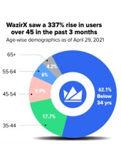
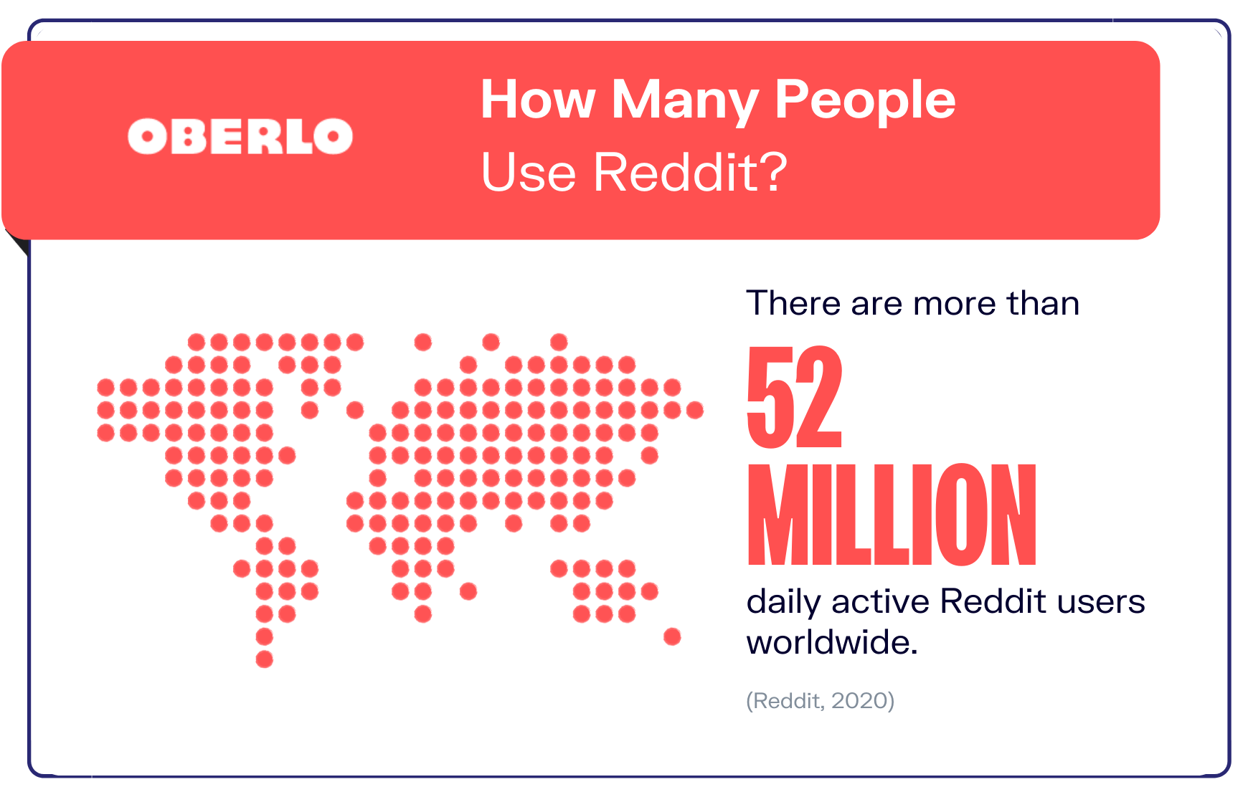
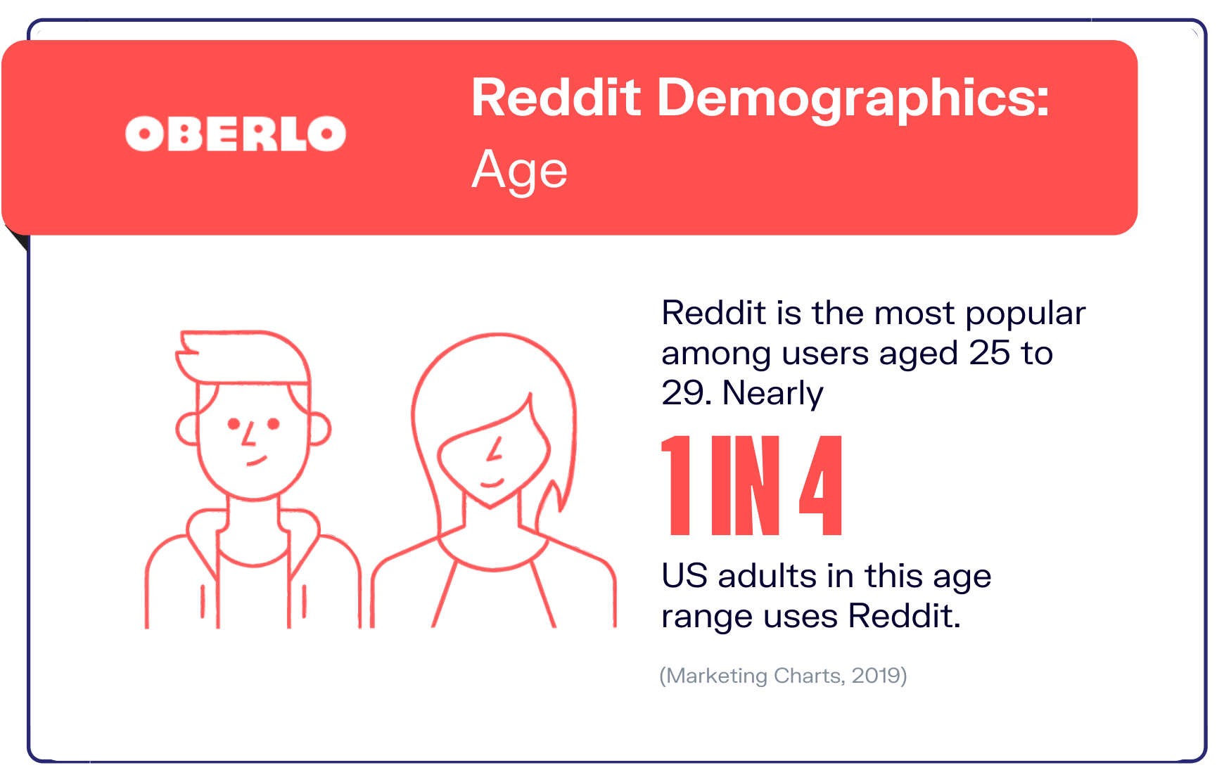
2 min to convince the audience
Recent reports have shown that there are nearly 1.8 million Reddit posts made daily.
Since Reddit and Crypto currency is most popular among users aged below 35, the forum holds huge collection of daily discussions on the Cryptocurrency topic.

Slide 3
Context and Introduction
This huge amount of information calls for machine learning methods to extract and analyze the data to retrieve meaningful topics, provide unique insights into texts and give you new ways to organize documents.
The aim of this project is to discover the abstract topics that occur in Bitcoin related discussions. This proposed approach will be able to draw out and classify texts to different topics and cluster the frequent similar information together.
We will also be seeing if the sentiments of the discussions are correlated with the change in the bitcoin prices.

Slide 4
Overview of Solution
Our solution involves the comparison between these three topic modelling techniques:
LDA (Latent Dirichlet Allocation)
LSA (Latent Semantic Analysis)
PLSA (Probabilistic Latent Semantic Analysis)
We will be discussing how we evaluated the performance of the models and tuned them to get better results
Using weighted means on semantic scores, we will see if topics are correlated with the daily price change in Bitcoin.

Slide 5
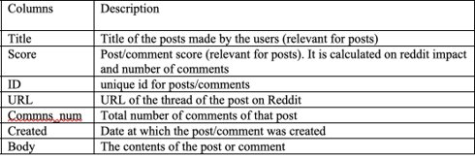
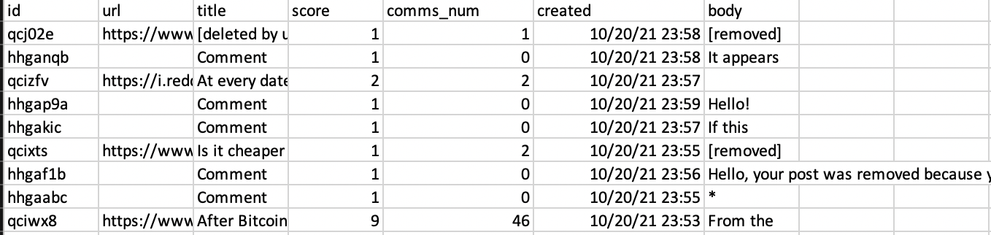
About Data
In this project two datasets are being used
Reddit Posts dataset with 237,191 records and 7 columns.
The bitcoin price dataset with 275 records and 7 columns.
The former dataset contains a lot of missing values in body and title columns, while the latter dataset doesn't have any such issues.
Description of Reddit Posts Dataset:

Slide 6
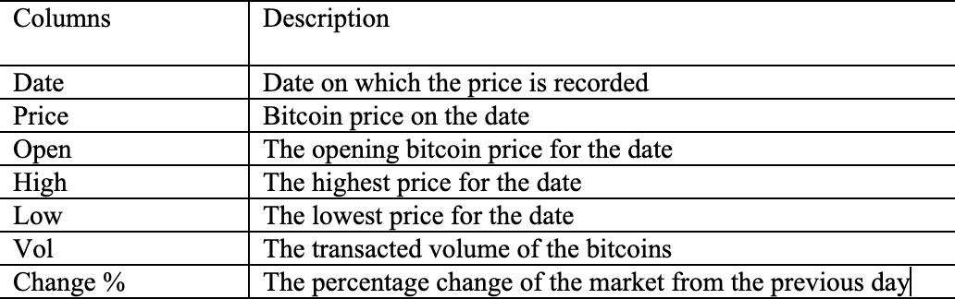
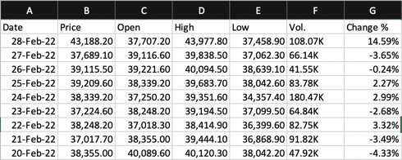
Description of Bitcoin Price Datasets:

Slide 7
Data Collecting
Reddit Posts Dataset
The reddit data is scraped using the python wrappers and PushshiftAPI.
Bitcoin Price Dataset
The historical data is downloaded from the investing website for the same timeframe as the reddit posts data is collected.
PRAW PSAW PMAW
search_submissions
search_comments
Data Extracted

Slide 8
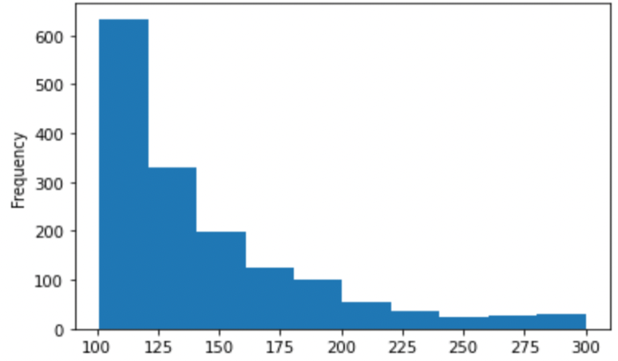
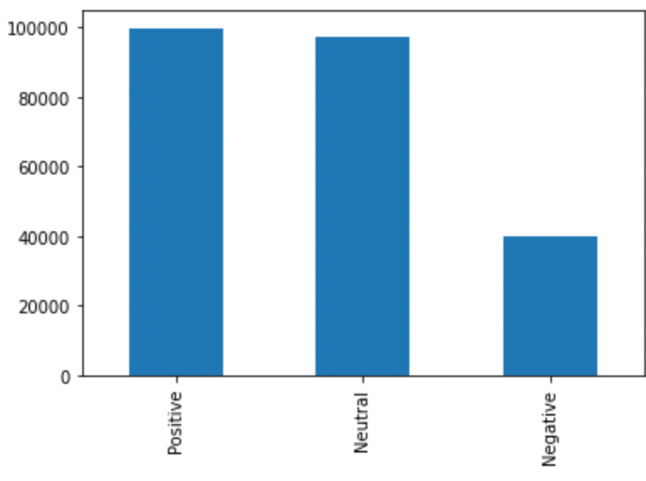
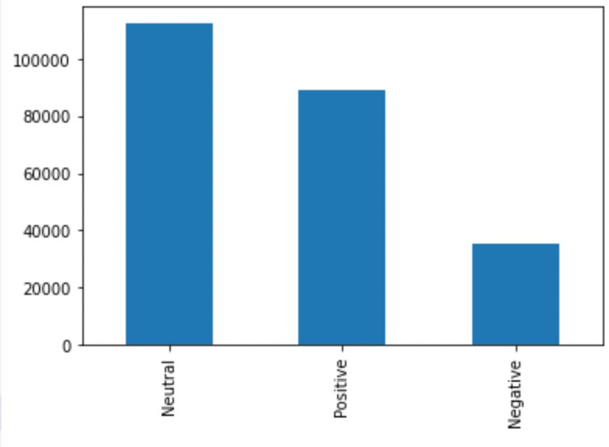
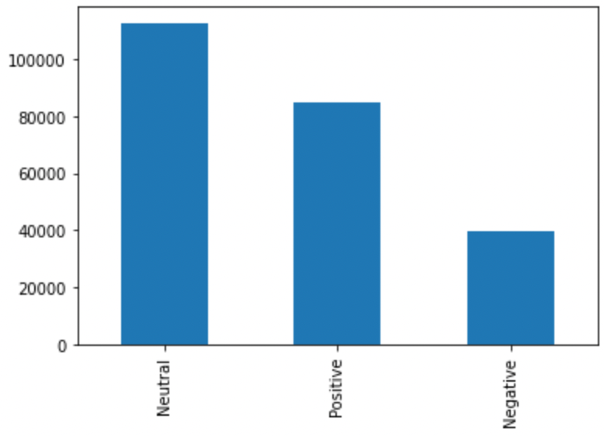
EDA
The Frequency chart of the title column of reddit posts dataset
The count of Positive, Negative and Neutral Sentiments in the dataset (Vader, TextBlob, AFINN)

Slide 9
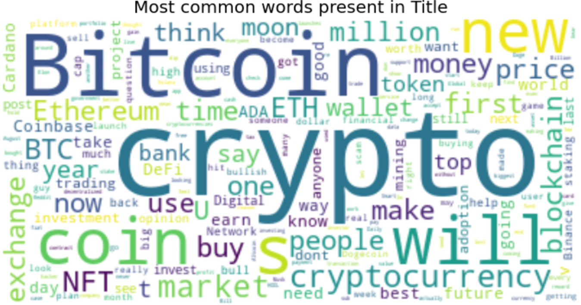
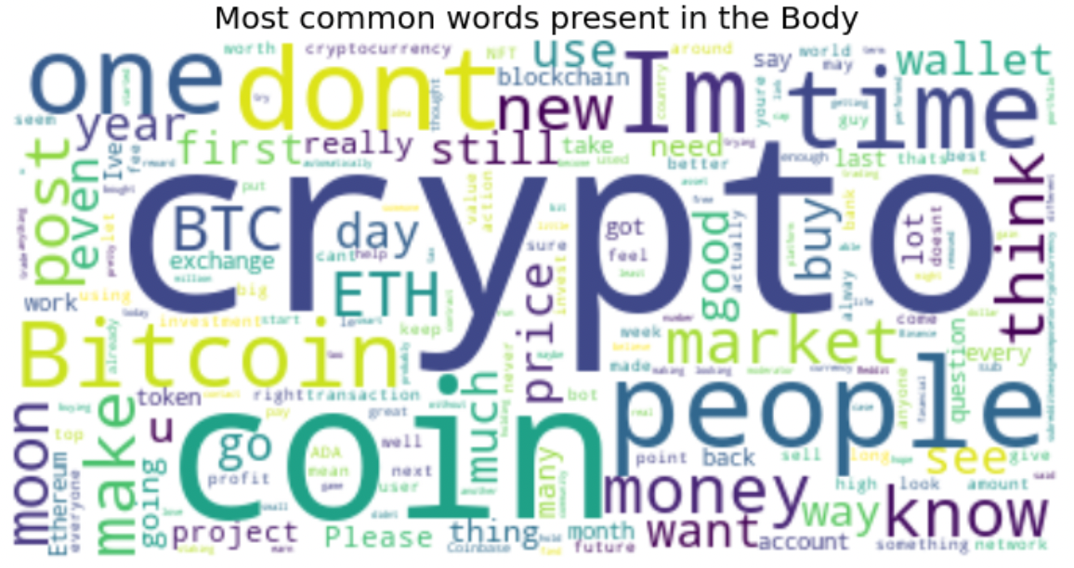
Cont..
The word cloud exhibiting the recurrent words present in the title and body columns.

Slide 10
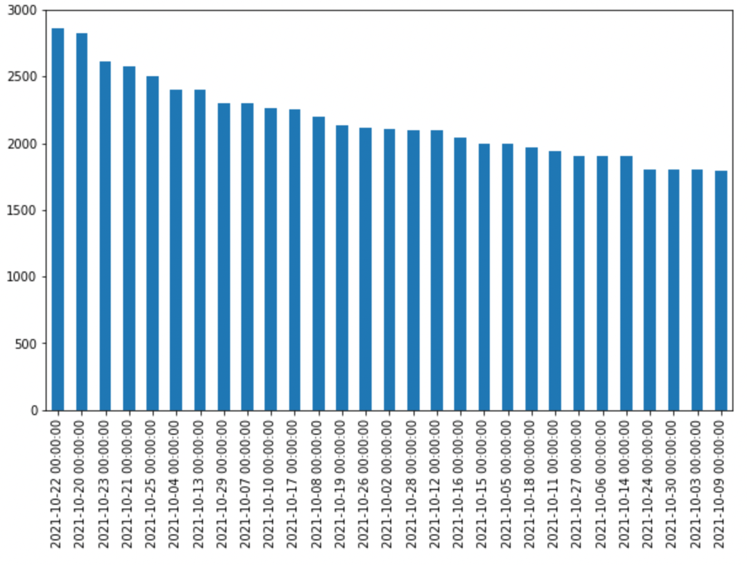
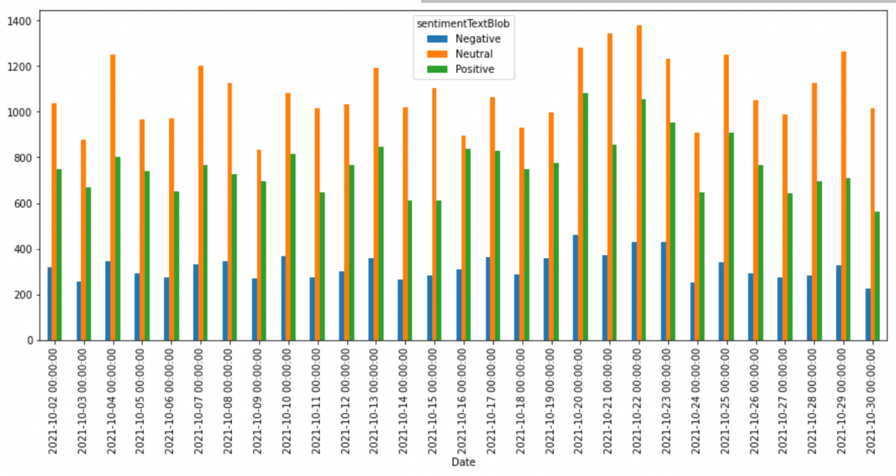
Cont..
The Number of posts per day to the sentiments observed on the same dates in the month of October 2021.

Slide 11
Challenges
One of the main challenges is that most of the data is present in the form of short text formats (from the comments and topic posts) which makes it tough to extract topics.
Next challenge is to use appropriate preprocessing techniques to ensure that the data is neither overfit nor underfitted.
Another challenge is to estimate the number of important topics that are to be extracted from the posts and comments.
And next challenge is there are a lot of the posts in the dataset with a lot of symbols, numbers or exclamations, such records are needed to be identified and removed.
Lastly, we also have words that are either obvious or do not hold much significance while appear frequently such words are needed to be pruned.

Slide 12
Related Works
We compared and generated the models to extract the topics for the reddit posts using the 3 different algorithms namely LDA, LSA and pLSA using the coherence and perplexity score.
With that figured the ideal number of topics using the coherence score and implementing the bigrams and trigrams for the LDA.
But also, found the sentiment correlation of the data using TextBlob, AFFIN, & Vader.
This approach is not found in any other Kaggle projects or publications and is unique to this project.

Slide 13
Data Preprocessing
Created a new field combining the text from the columns "body" and "title". In quite a lot of cases one or both of these columns had empty values
'NA' values in columns had to be removed
The column “created” had date values in many different formats, we had to standardize this and bring it into one single format
Using Regex, symbols, special characters and numbers were removed
A lot of posts contained phrases which did not add any meaning like "comment" , "deleted", "removed" etc . These had to be removed.

Slide 14
Data Preprocessing - continued
Stop words were removed using the NTLK stop words list
A new weighted Score field was created by assigning each record a score with respect to the percentage of its proportion of the overall sum of scores.
The format of the date values in the BitcoinPrice dataset had to be converted to match the date value format of the Reddit data set.
The format of the %change value field in the BitcoinPrice dataset had to be changed.

Slide 15
Methodology: LDA modelling
As we know PCA is for reducing the dimensions by focusing on attributes with most variations. It is mainly used when we need to plot high dimensional data onto a simple x-y plane.
But in our case, we are not interested in attributes(documents) with most variations, instead we are interested in maximizing the separability between K topics while minimizing the variability within topics.
This is done by maximizing the distances between mean of the topic and the center point and by minimizing the variation within each category.
The first axis of PCA accounts for most variation in data, but in the case of LDA it accounts for the most variation between the categories.

Slide 16
Demo shows:
LDA with 10 topics
Coherence score and perplexity
Optimum number of topics and LDA improvement
Hyperparameter tuned LDA
Bigram trigram implementation

Slide 17
Evaluation Metrics
Perplexity is defined as the normalized log-likelihood of a model being shocked by fresh data it has never seen before.
Recent research has found that prediction likelihood (perplexity) and human interpretation are frequently unrelated and sometimes anti-correlated.
Topic Coherence is a metric that assesses the degree of semantic similarity between frequent words in a single topic. If a group of words in statements supports each other, it is said to be coherent.
The lower the perplexity and the higher the coherence score the better the model is performing.

Slide 18
Hyper parameter tuning
Alpha is used to address if most documents have a few topics, or many topics. It expresses sense of how topically sparse each document is.
In smoothed LDA, each topic βk is drawn from a Dir(η)(topics), and words from this topic are drawn from a categorical distribution with parameter βk. Meaning, this expresses how word-sparse we expect topics to be.

Slide 19
Methodology: LSA modelling
LSA is a type of principal component analysis that is used to analyze text data. It's an approach based on linear algebra. LDA is a probabilistic algorithm that employs the Dirichlet prior. Priors can be thought of as extra information. LDA is less prone to over-fitting difficulties due to the priors.
Both methods provide orthogonal vector representations of the documents and words. In LSA, we show orthogonal representation, but in LDA, we represent independent topics.
LSA models are also unable to capture the multiple meanings of words.

Slide 20
Methodology: PLSA modelling
Instead of using matrices, PLSA uses a probabilistic method. The goal of PLSA is to minimize the dimensionality of the sparse co-occurrence matrix by factorizing it, whereas LSA uses the singular value decomposition method.
PLSA topic modelling technique isn't there in gensim library and with the sklearn implementation of PLSA there is no function to check the coherence score, so we could not compare the results of PSA with LDA model.
Another approach is LDA model with parameters alpha=symmetric and eta=symmetric works as PLSA. Setting alpha and beta doesn't exactly produce PLSA however it does make the Dirichlet prior dense which is more like PLSA.

Slide 21
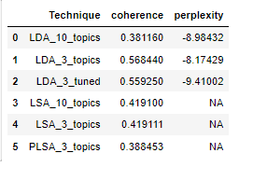
Results (PLSA vs LDA vs LSA)
PLSA (LDA with alpha=1 and eta=1) gave lesser coherence score than LDA with alpha 0.9 and beta 0.01, we can conclude that LDA performs better.
LSA faced issue with separability, and has lower coherence score hence we can conclude that coherence score and perplexity is the best for LDA hyper tuned models with 3 topics.

Slide 22
Sentiment analysis
Three packages , namely TextBlob, AFFIN and Vadar were used to calculate the polarity of the Reddit texts.
The text field was first tokenized using NLTK
Stop words were removed from this using NLTK stopwords set. Irrelevant words / phrases were further removed from this using Regex
The text was then Lemmatized and Stemmed using NLTK
For this processed text obtained, the polarity scores are calculated separately using the 3 packages mentioned above

Slide 23
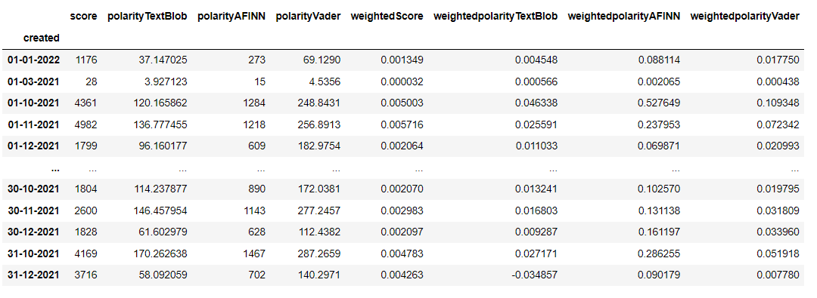
Semantic analytics - continued
The polarity scores are then scaled using the weighted score created
These scores are then aggregated day wise , to check for correlation if any, with the daily change in price of bitcoin

Slide 24
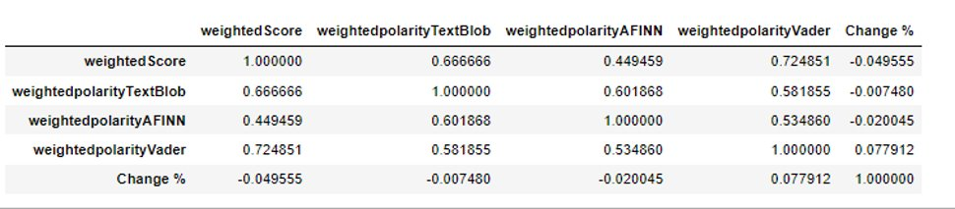
Semantic analytics - continued
Given below is the correlation between the 3 weighted polarity scores and the percentage change in the price of bitcoin each day

Slide 25
Future Work
Extending the date range over which the analysis takes place
Extract more features related to reddit data and see how they correlate with price change
We can extend the topic modelling techniques to other cryptocurrencies as well.
Try out more topic models
Try out more complex sentiment analysis

Slide 26
THANK YOU

Slide 27
Summary of LSA vs LDA vs PLSA (Bonus slide)
LSA -> uses SVD, and as a result the topics are assumed to be orthogonal.
PLSA -> Treats topics as word distributions, uses probabilistic methods, and topics are allowed to be non-orthogonal.
LDA -> similar to PLSA, but with Dirichlet priors for the document-topic and topic-word distributions. This prevents over-fitting and gives better results.

